Slide 1
Enhancing Reliability of 5G Communication Services With Guaranteed Delay

Slide 2
Here we propose a novel solution called eRESERV to enhance the reliability of 5G communication services without assigning backups to VNFs of an SFC.
We divide the SFC (also called as service chain) into multiple subchains of SFCs with lesser capacity VNFs
Queueing theory is proposed based on the algorithm which decides the number of subchains that can be created from an SFC.

Slide 3
Introduction
SFC or simply service chain involves instantiation of an ordered list of network/service functions and connecting them together as a chain of network functions
NFV facilitates easy provisioning of services by dynamically placing VNFs in the virtual environment and chaining them together as an SFC.
A number of VNFs are placed on a set of servers and chained to create multiple SFCs.

Slide 4
Disadvantage:
Failure of a single VNF will bring down the entire chain of SFC.
Failures may happen both at the substrate network and virtual network, but the frequency of failures at virtual network is higher than substrate networks.
A common approach to achieve higher reliability and meeting delay constraints is by placing redundant network elements (also called as backup).

Slide 5
eRESERV
Enhancing REliability of SERVice chain(eRESERV)- enhances the reliability of an SFC while meeting the delay constraints of the SFC.
minimizes the resource requirement of an SFC
By extensive simulations it is seen that the effectiveness of the proposed solution in terms of reliability, expected response time, and resource requirement is quite high as compared to traditional backup settings.

Slide 6
Network Model
N represents the set of physical nodes
L represents the set of physical links.
SFCs are created at the virtual network in the cloud data center to provide services for various network service requests.
The virtual network is represented as a graph G_{v} = (V, E), where V represents a set of VNFs and E represents a set of virtual links in the system.
VNFs are hosted on the physical servers and virtual links are created to interconnect VNFs and carry virtual network traffic over the physical links.
The physical and virtual network resources together form NFVI, which is managed and controlled by VIM along with SDN controller.

Slide 7
The set of all SFCs provided by a service provider is denoted by S.
Each SFC s ∈ S provides a particular service and is represented as an acyclic directed graph Gs = (Vs, Es), where Vs and Es represent the set of VNFs in sequential order and the set of links that interconnect these VNFs, respectively.
Each SFC provides a particular service.

Slide 8
set of VNFs V_{s}
service request s ∈ S has a latency requirement denoted by Ψs
arrival rate λs
Each VNF v ∈ V is considered to have a processing rate of µ_{v} and follows an exponential distribution with corresponding response (both waiting and processing) time ψ_{v}

Slide 9



Enhancing Reliability of an SFC
Consider an SFC s as shown in the next figure which requires four VNFs, i.e., |Vs| = 4 and has arrival rate λ_{s}.
Each VNF v is reliable with probability p_{v}.
If an SFC s provides a service for a service request which has delay constraint of Ψs, then .
The resource requirement of SFC s is
If each VNF v ∈ V_{s} is reliable with a probability p_{v}, then the reliability r_{s} can be calculated as:-

Slide 10
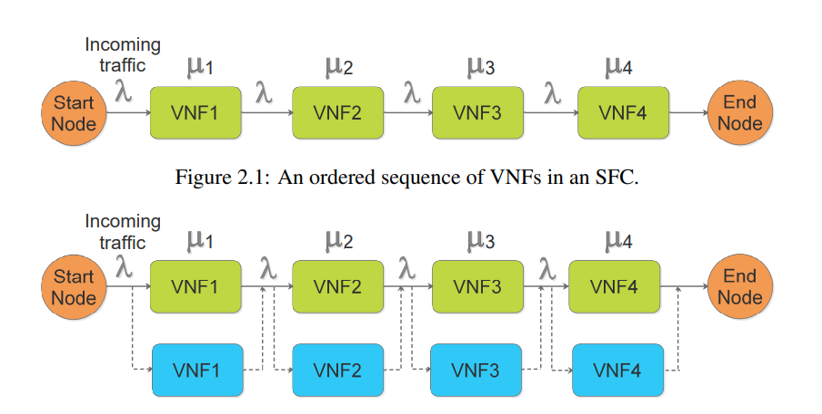
An SFC with single dedicated backup

Slide 11


Each VNF is provided with a dedicated b number of backups.
Now, reliability p_{v}(b) of each VNF v ∈ V_{s} can be calculated as:-
the new reliability of the SFC is:-

Slide 12

Clearly, r_{s}(b) > r_{s} ∀b ≥ 1. However, the number of resources now required for the SFC s will be:-
Disadvantage- Though it increases service reliability but the redundant backup resources are idle until a failure happens in the primary nodes or links.
Thus we use eRESERV method.

Slide 13

Theorem 1:
Dividing an SFC into subchains of SFC with VNFs of lesser capacity will increase the reliability of the system:-
An SFC s with arrival rate λ_{s} is divided into l subchains with each VNF v ∈ V_{s} having processing rate of µ_{v} /l and each subchain having an arrival rate of λ_{s} /l .
However same software functionality is performed as that of original VNF.
Reliability of each VNF is still p_{v}. Let each subchain of ‘s’ be represented by

Slide 14
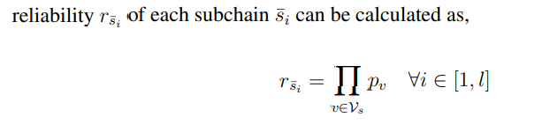

Slide 15
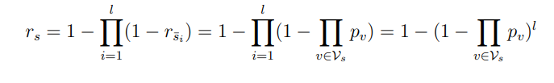
For the system to be reliable, at least one of the subchains must be active. Therefore, reliability of the system r_{s} can now be calculated as:-

Slide 16

Differentiating the above equation with respect to l, we get:-
As r_{s} is an increasing function with respect to l and there do not exist any extreme points for all l ∈ N, we can say that r_{s} increases with increase in l.

Slide 17
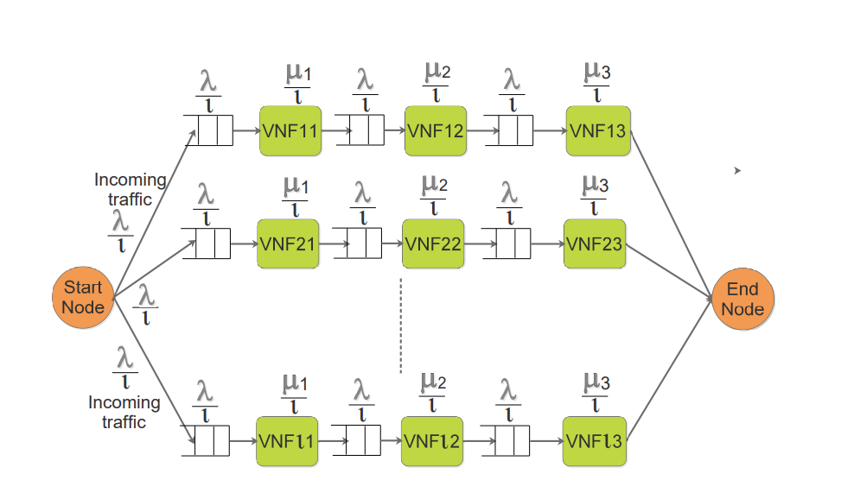
Sub-chaining as M/M/1 tandem network of queues.

Slide 18
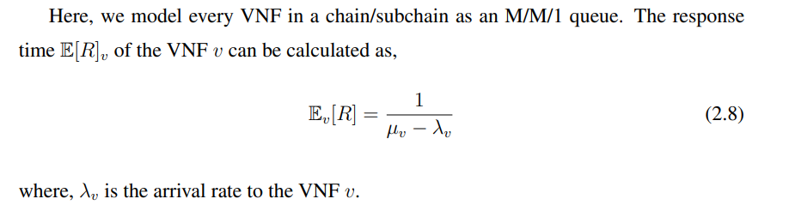
Response time

Slide 19

For an SFC s with |Vs| number of VNFs.
By Burke’s theorem, λ_{v} = λ_{s} ∀v ∈ V_{s}.
The expected response time Es[R] of the SFC can be calculated as:-

Slide 20
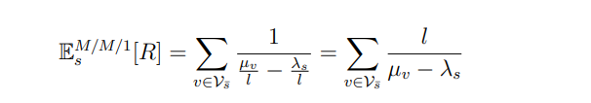
Now, consider an SFC which is divided into l subchains. As every packet traverses one of the subchains, say s¯, the expected response time of the SFC can be calculated as:-

Slide 21
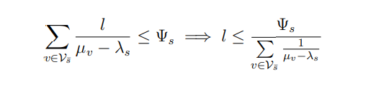
As every SFC s has the delay constraint of Ψs, the delay incurred in an SFC with subchains should not exceed Ψs. Therefore:-

Slide 22
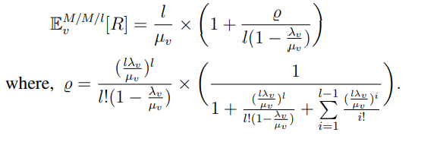
Decreasing Response Time
We propose to have a common scheduler for every VNF instead of having an individual scheduler for each VNFs.
If a VNF is divided into l smaller VNFs, then the expected response time of a VNF v can be calculated as:-

Slide 23
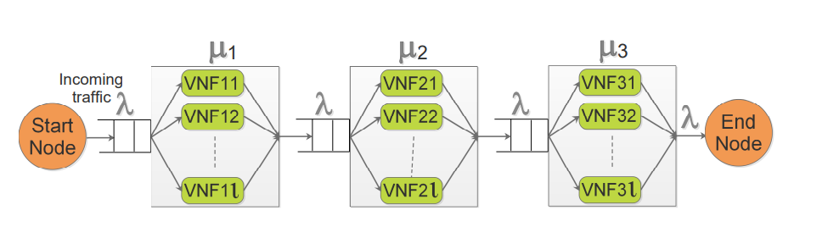
Subchaining as M/M/m tandem network of queues.

Slide 24
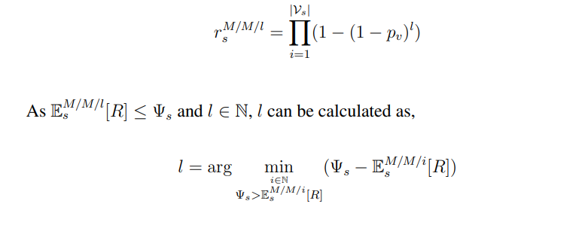
Analyzing Reliability and Estimating l
The system will be active if any one of the smaller VNFs is active at every VNF of an original SFC. Therefore, the reliability r M/M/l s of the new M/M/l system is given by:-

Slide 25
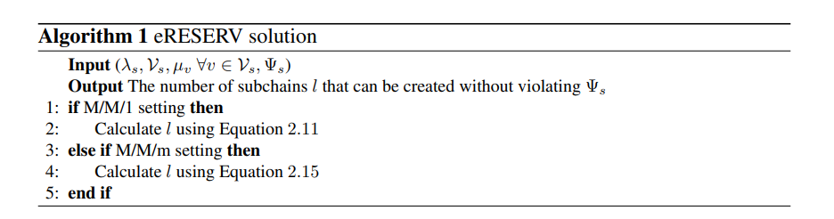
If the preferred setting is M/M/1, then the number of subchains can be calculated in O(1) time. If the maximum number of subchains that can be made is l_{max}, then the number of subchains in M/M/m setting can be calculated in O(log(l_{max})) time using binary search.

Slide 26
Performance Analysis
In SC setting, the reliability is always constant
In SCB the reliability increases with increase in the number of backups.
the reliability in eRESERV settings increases with increase in number of subchains.
M/M/m setting matches the reliability offered by the SCB setting, but consumes way less resources when compared to SCB setting.

Slide 27
Results
The number of subchains created decreases with an increase in the number of VNFs in an SFC.
However, the number of subchains created is more in M/M/m setting than in any other settings. This is due to the fact that, the expected response time in M/M/m setting is lesser than in M/M/1 setting when the number of subchains is increased.
The proposed settings are able to meet the delay constraint at every instance of time. Although the response time in the proposed settings is higher than in SC and SCB settings, the reliability is the highest in M/M/m setting (with minimum amount of resources).

